Slide 1
DIGITAL AUDIENCE REPORT
December 2023

Slide 2
N^{o.} 1
News
App
3.1m
App
Downloads
RTÉ News is the Number 1 news and entertainment app in Ireland
News Apps Ever Use – November 2022 (Adults 18+)
Source: B&A Survey, Nov 2022 (Adults 18+ in Ireland)

Slide 3
Digital Service Usage
47% of Irish adults use a digital service from RTÉ every week (2022)
47%
Source: B&A 2022. Weekly+ reach for RTÉ.ie, RTÉ News Now Online, RTÉ Player, RTÉ Radio Player, Other RTÉ Apps)

Slide 4
RTÉ News App – Unique Browsers Per Month

Slide 5
RTÉ News App – Page Views Per Month

Slide 6
Page Views Per Device

Slide 7
Ireland’s
No. 1 Multi-Media Website
8 mins
Average
Visit
8 million Monthly Unique Browsers
RTÉ.ie is the Number 1 multi-media website in Ireland, used by 41% of adults in Ireland
News & Entertainment Websites Ever Use– November 2022 (Adults 18+)
Source: B&A Survey, Nov 2022 (Adults 18+ in Ireland)

Slide 8
RTÉ.ie – Unique Browsers Per Month

Slide 9
RTÉ.ie – Page Views Per Month

Slide 10
RTÉ.ie – Page Views Per Device

Slide 11
4.2M
RTÉ Player App Downloads
Ireland’s No.1 BVOD service
RTÉ Player is the Number 1 broadcaster video on demand service used by 42% of adults in Ireland
BVOD Services Ever Use– November 2022 (Adults 18+)
Source: B&A Survey, Nov 2022 (Adults 18+ in Ireland)

Slide 12
RTÉ Player – Unique Browsers Per Month

Slide 13
RTÉ Player – Streams Per Month

Slide 14
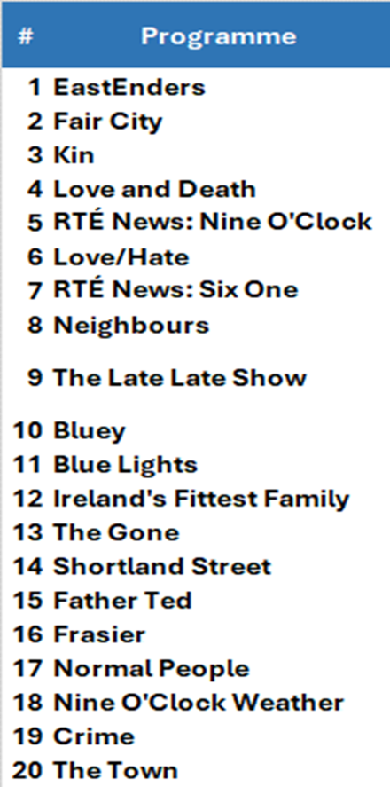
RTÉ Player – Top Programmes
Top Titles - December 2023

Slide 15
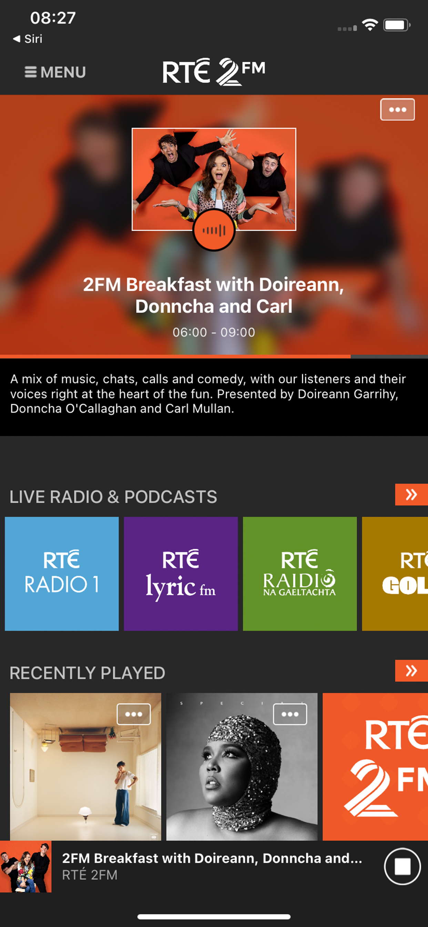
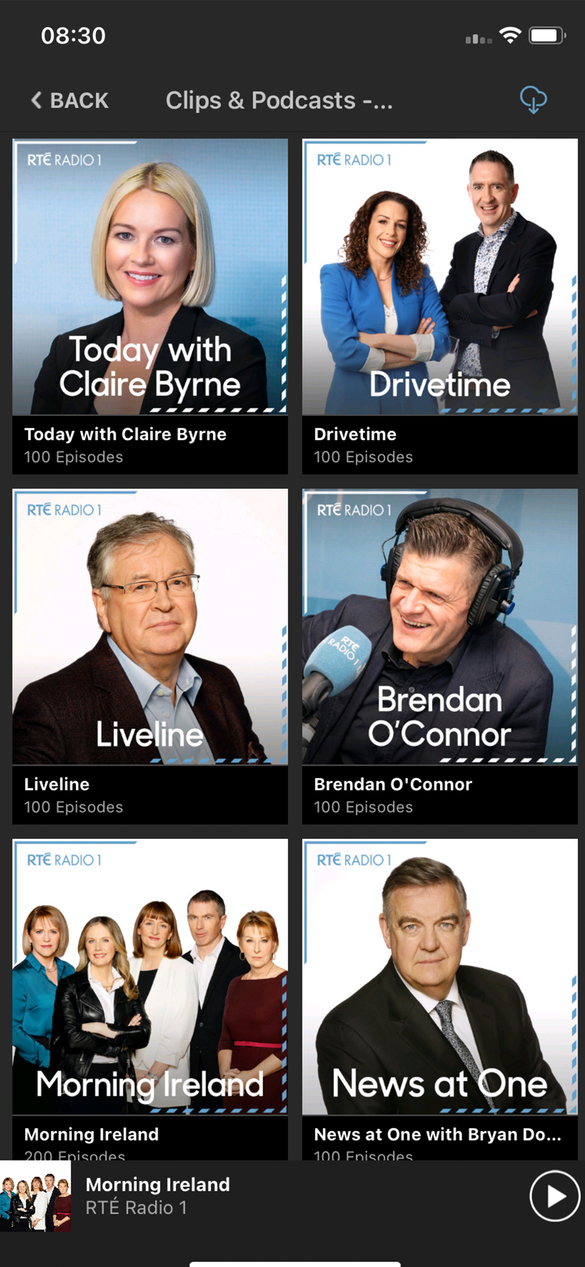
Audio

Slide 16
RTÉ Audio – Unique Browsers Per Month

Slide 17
RTÉ Audio – Streams Per Month

Slide 18
RTÉ Audio Streams by Broadcast Type

Slide 19
RTÉ Audio Streams by Device

